Slide 1
COVID-19 AND Lung Cancer
Gregory J. Riely

Slide 2
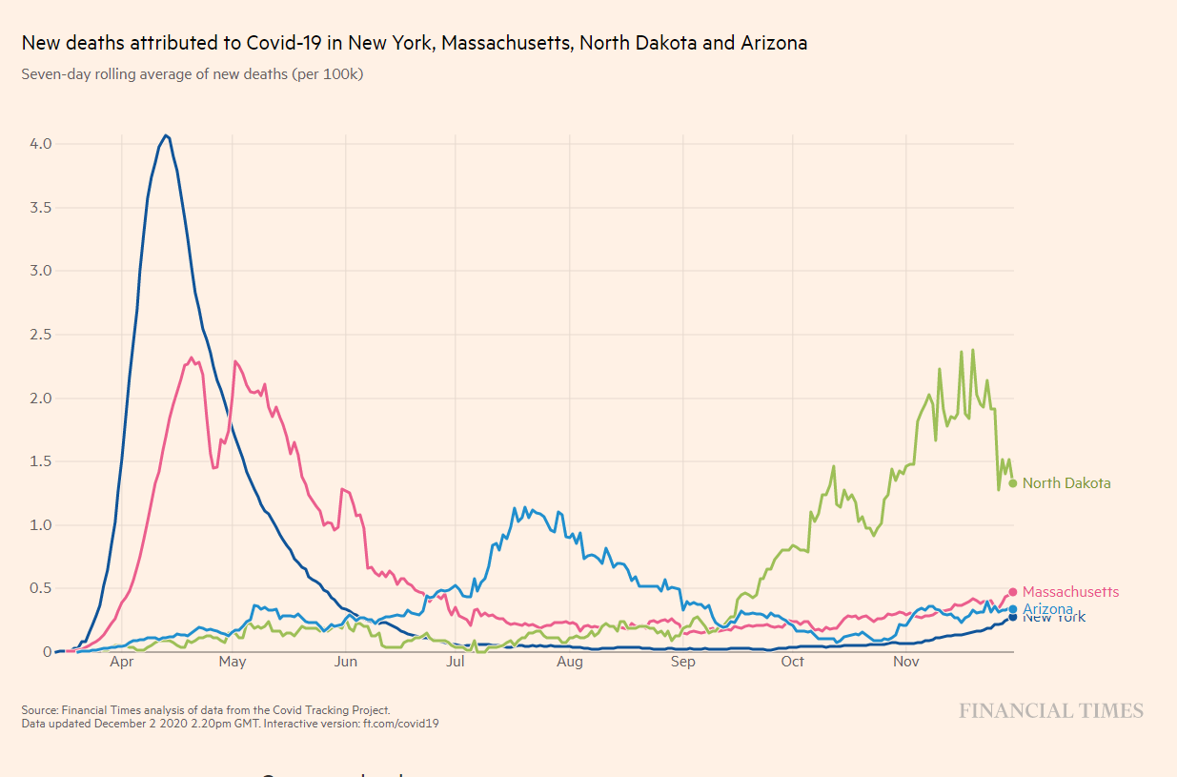
Reminder of the timing of COVID-19 in the US
NY
North Dakota
Mass
Arizona

Slide 3
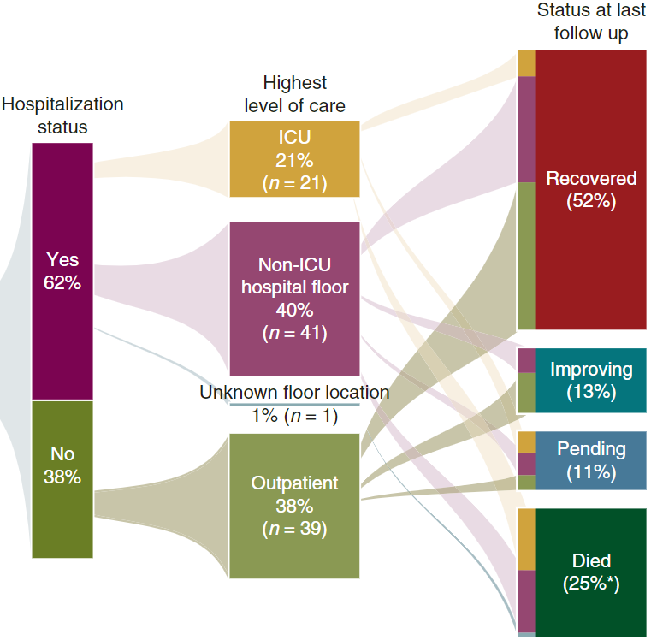
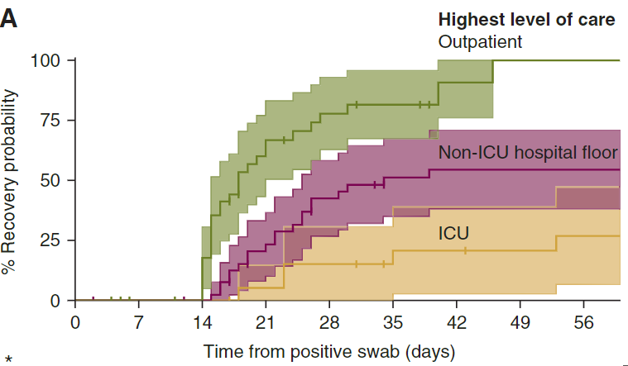
Outcomes of lung cancer and COVID-19 (NYC, first wave 2020)
Luo et al, Annals of Oncology 2020

Slide 4
Outcomes of lung cancer and COVID-19 (NYC, first wave 2020)
Predictors of worse outcome:
Age
Cigarette Smoking (pack years)
COPD
Hypertension
Not predictive:
Prior thoracic radiation
Prior thoracic surgery
Recent chemotherapy (<3 wks)
Luo et al, Annals of Oncology 2020

Slide 5
Lung cancer is still the problem
deaths not from confirmed COVID-19
confirmed COVID-19 deaths
all deaths
(%)
deaths from confirmed COVID-19
Modified from Luo et al, Annals of Oncology 2020

Slide 6
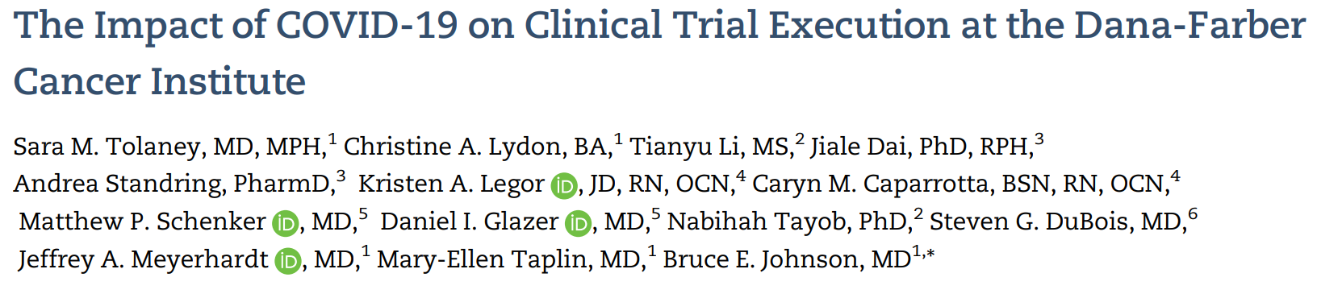
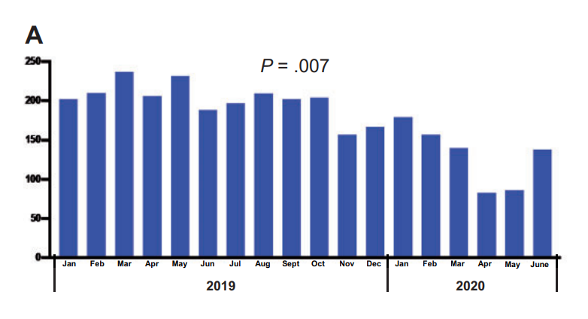
Therapeutic Clinical Trial Activity
Peak COVID-19 in MA
Tolaney et al JNCI 2020

Slide 7
Conclusions
Outcomes with COVID-19 are worse in patients with COVID-19, but significant majority recover
Lung cancer is still the underlying problem that we need to address, with prioritization of clinical trials
Ongoing collaborative initiatives to look at interplay of COVID-19 and lung cancer: CCC-19, Terravolt, ASCO

